Slide 1
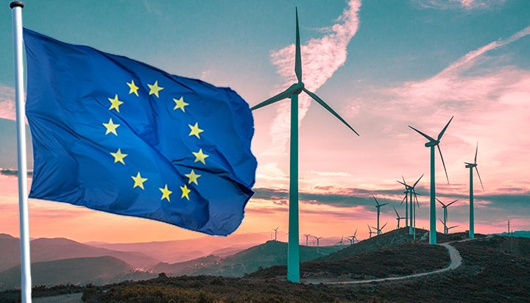
Energy Security In The Mediterranean
INTERNATIONAL ENERGY FORUM
MEDITERRANEAN ENERGY
Energy Security in the Mediterranean
Dr. Ariel Cohen
July 24, 2020

Slide 2
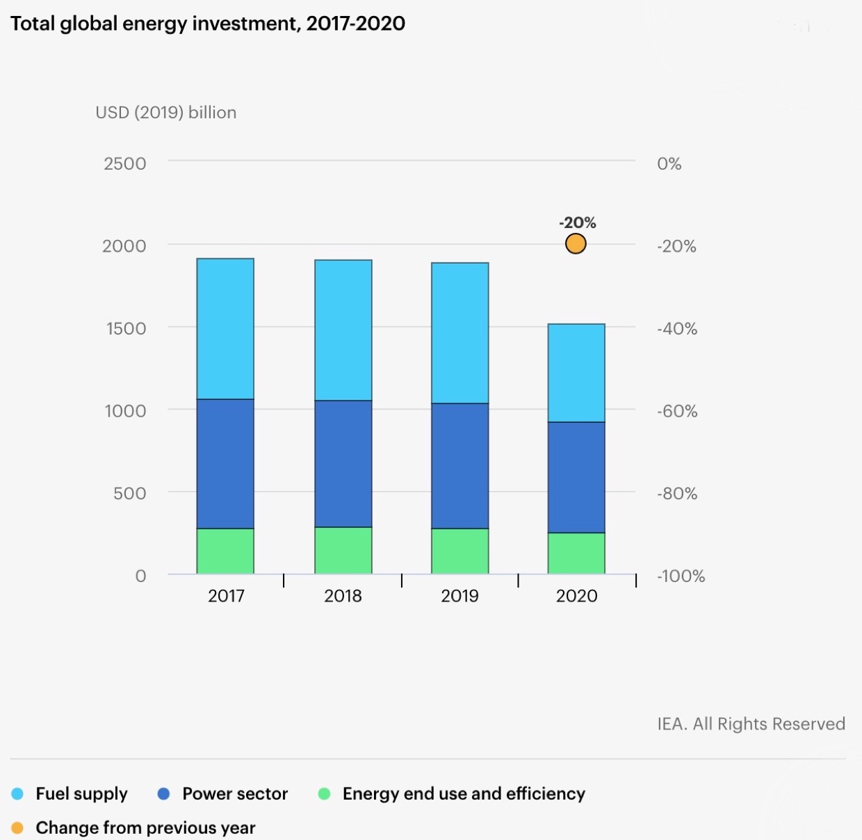
Impact of COVID on World Energy Markets

Slide 3
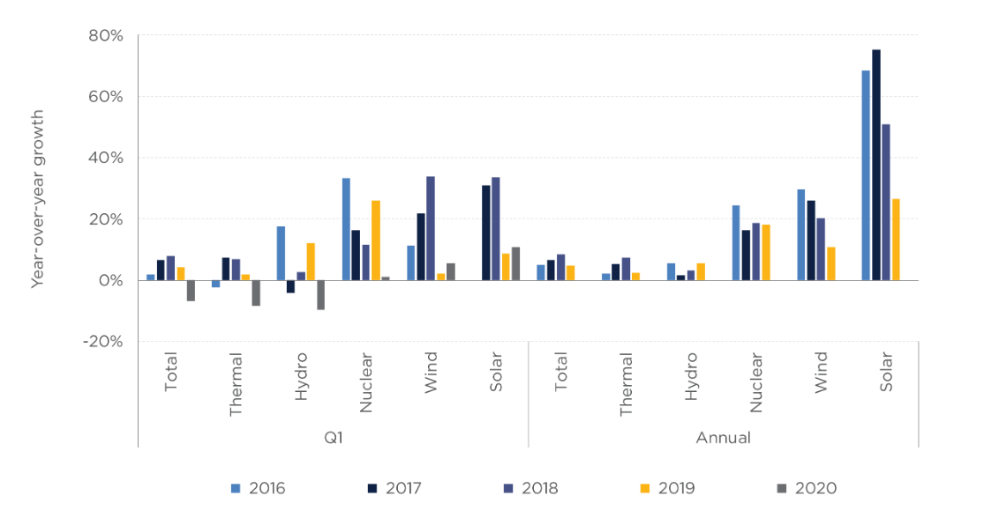
Impact of COVID on World Energy Markets CHINA
Growth Of Power Generation By Fuel In China During The 13th Fyp Period For Q1 And The Whole Of Each Year
Columbia SIPA

Slide 4
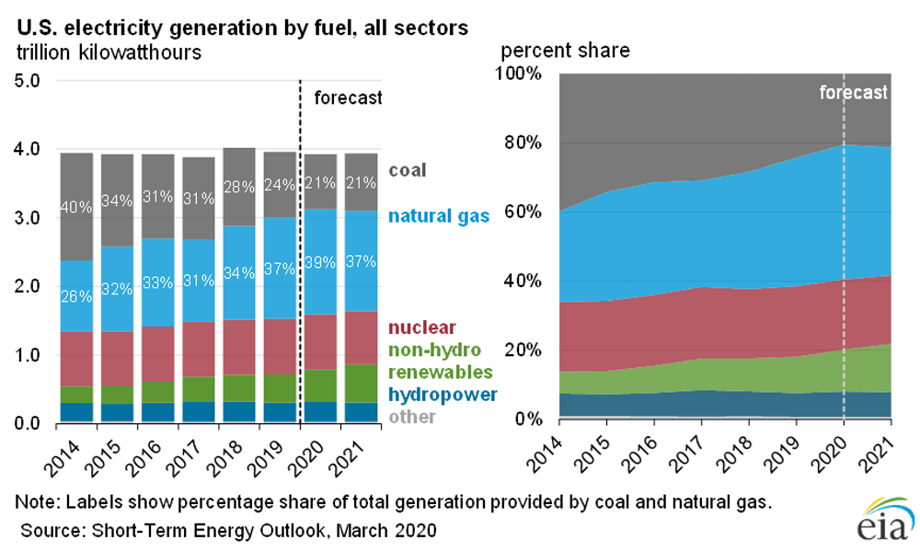
Impact of COVID on World Energy Markets USA

Slide 5
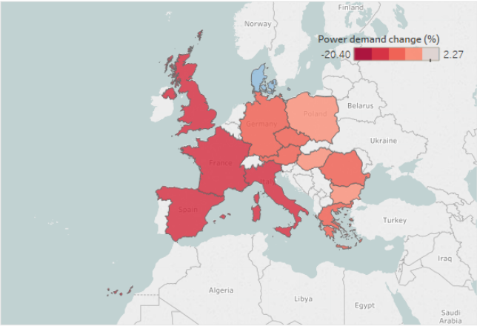
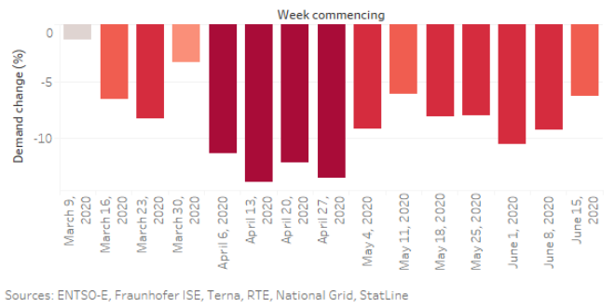
Impact of COVID on World Energy Markets
Power Demand Change
vs.
Five Year Average in the European Union

Slide 6
Covid-19 Tests The EU’s Resilience And Clean Energy Transitions
In 2020, the EU is facing a 7-10% economic downturn due to COVID-19
Financial resilience of the EU energy sector is under severe stress
Investment in renewable energy is set to decline by one-third in 2020
Politico Europe

Slide 7
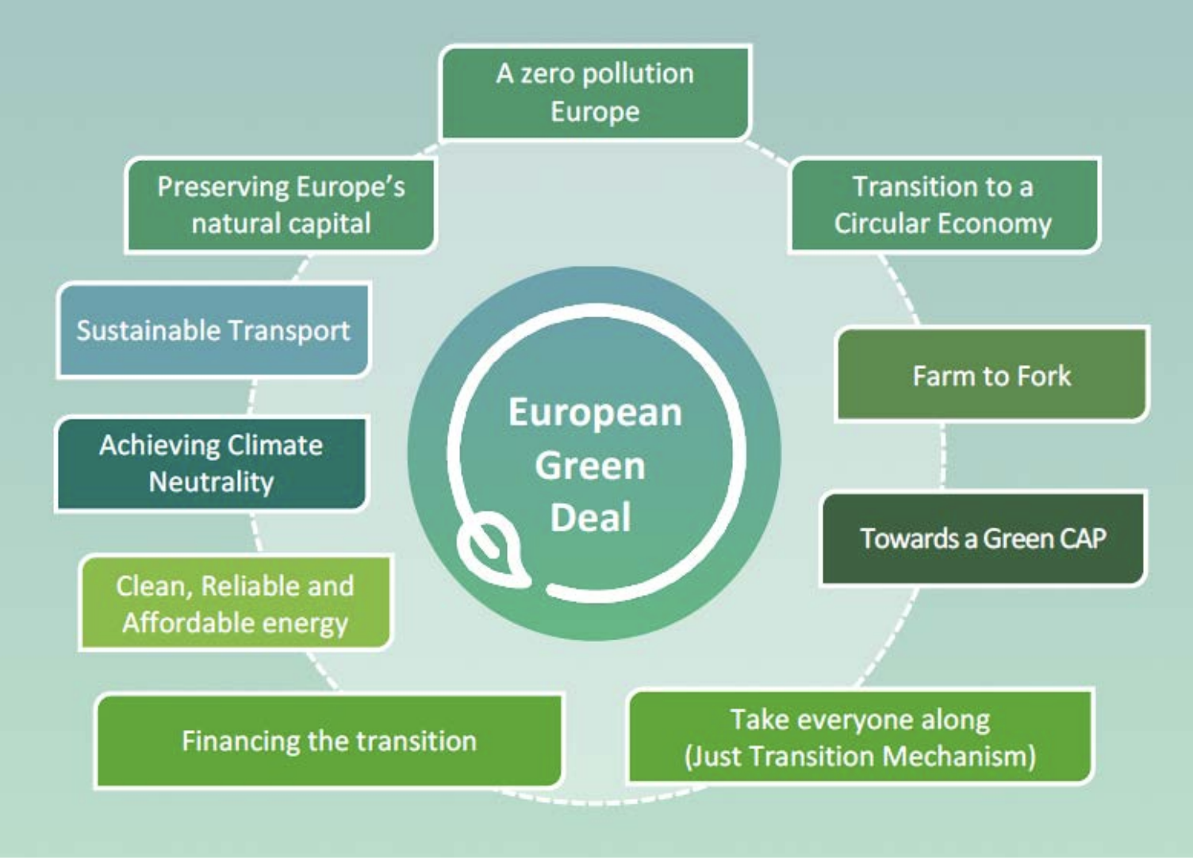
Energy Sector Action Is Central To The European Green Deal
Europe’s energy transitions progressed fast in electricity
The EU is not yet on track towards the targeted increase of the renewables share to 32% by 2030
The EU should accelerate the implementation of the current policies and regulations of the EGD and focus on energy system integration
Energypost.eu

Slide 8
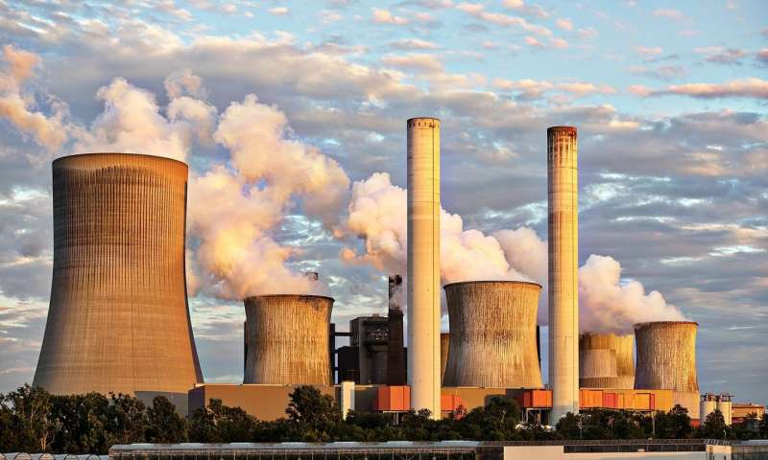
EU Traditional Power Sources
Coal
Consumption: 176 Mtoe
Production: 65 Mtoe
Natural Gas
Consumption: 469.6 bcm
Production: 101 bcm
Nuclear
In 2019, 14 EU members had 126 nuclear power reactors in operation in 14 EU member states

Slide 9
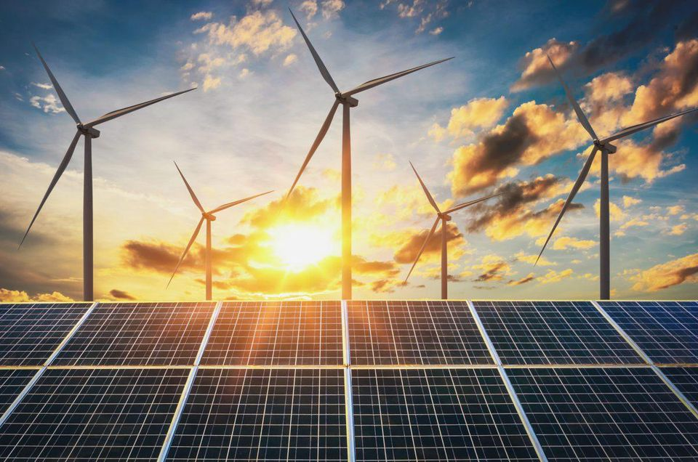
Scaling Up To Net Zero
In 2019, EU members states agreed to the climate neutrality goal by 2050
Efficiency gains across all sectors will continue to be vital for EU member states
EU power system is going to be characterized by higher shares of variable renewables with wind expected to become the largest power source
Investments in alternative energy tech (storage, hydrogen, smart grids) must be prioritized
System integration must be an EU’s regulatory priority
Cleantech.org

Slide 10
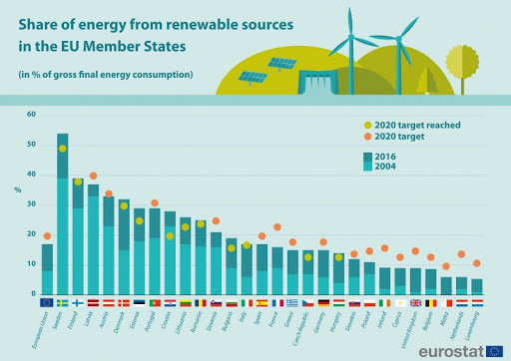
Renewable Energy Leaders of the Mediterranean
Morocco and Turkey are examples of countries with significant portion of their energy mix coming from renewable sources.
Sweden, Finland, Latvia, Denmark and Austria have surpassed ren. targets

Slide 11
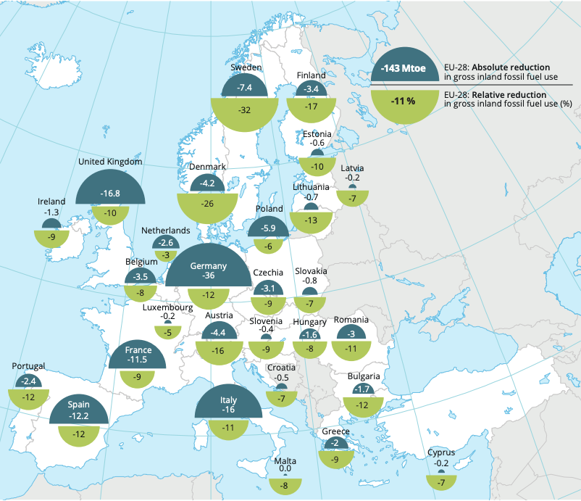
Renewable Energy in Italy and Spain
In the first two months of 2020, over 42% of Spain’s electricity came from renewable sources;
With enormous potential for solar power development, Spain is also Europe’s 2nd in wind power installations as of 2019;
Italy reached its 2020 energy strategy target of 17% of renewables in gross energy consumption in 2014
World Economic Forum

Slide 12
Areas With Future Potential
France and Greece are lagging significantly behind their 2020 targets, six member states are putting the EU goal of 23% at risk;
The transition to renewable energy sparked the 2018 yellow vest protests in France;
Over the next half a decade France, Morocco and Turkey have tremendous potential in terms of adding more renewable energy installations
Renewables will play an increasingly vital role in Europe's Energy Security as the Green revolution gathers political and economic momentum

Slide 13
Policy Recommendations
Boost energy sector action for Europe’s short-term recovery with large-scale programs for generation facilities and grid renovation, and by lifting barriers for investment in energy projects, and promoting the clean energy industries and infrastructure of the future
Implement the 2030 framework and review policies to scale up energy action towards climate neutrality while ensuring competitiveness, security of supply, sustainability and affordability.
Ensure the functioning of the internal energy market and the level playing field for energy technology development, investment and sustainable financing in the EU to keep all technology options open for achieving net-zero emissions.
Keep under regular review the EU’s energy security position based on foresight and long-term energy modelling at regional and EU levels, in line with European energy system adequacy assessments (NS2?)

Slide 14
Dr. Ariel Cohen, PhD
Dr. Ariel Cohen is a Senior Fellow at the International Tax and Investment Center (ITIC) where he heads the Energy, Growth, and Security Program (EGS). He is also a non-resident Senior Fellow at the Atlantic Council Eurasia Center and a member of the Council of Foreign Relations. He is a recognized authority on international security and energy policy, and leading expert in Russia, Eurasia, and the Middle East. Dr. Cohen is the Founding Principal of International Market Analysis Ltd., a boutique political risk advisory.
For over 20 years Dr. Cohen served as a Senior Research Fellow in Russian and Eurasian Studies and International Energy Policy at the Heritage Foundation. He directed Heritage’s energy war games and worked closely with Members of Congress and Congressional staff members as well as cabinet-level and sub-cabinet domestic and foreign decision-makers.
Dr. Cohen is the author of six books, 30 book chapters, and over 1,000 articles. He regularly appears on CNN, NBC, CBS, FOX, C-SPAN, BBC-TV, Bloomberg, Al Jazeera, and all Russian and Ukrainian national TV networks. Dr. Cohen is a regular commentator on Voice of America and Newsweek, as well as a weekly Forbes energy columnist.
He earned his Masters and Ph.D. from the Fletcher School of Law and Diplomacy.

