Slide 1
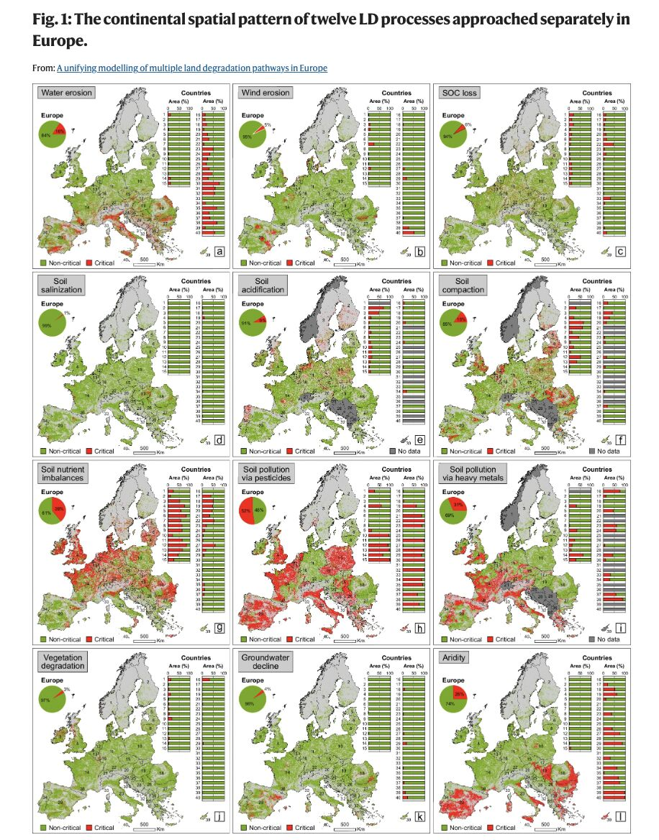
ENERGY TO WHOM?
FOR ROBOTS?
FOR AI?
FOR PEOPLE?
FOOD OR ENERGY?
NEED A RIGHT BALANCE
Water erosion
Wind erosion
SOC loss
Soil salinization
Soil acidification
Soil compaction
Soil nutrient imbalances
Soil pollution via pesticides
Soil pollution via heavy metals
Vegetation degradation
Groundwater decline
Aridity
PLANET - PEOPLE - PRODUCT
Energy security as a factor
of economic stability
SUPPLY STABILITY OF THE
HUMAN AND ENERGY
RESOURCES
DEPENDS ON
SOIL,
WEATHER,
PARNERSHIPS,
GOVERNMENTS.
VIII. INTERENEF SPLIT, 27.09/2024 PETER BIRO CLIMATE AMBASSADOR, ENERGY TRANSITION UN PROGRAM

Slide 2
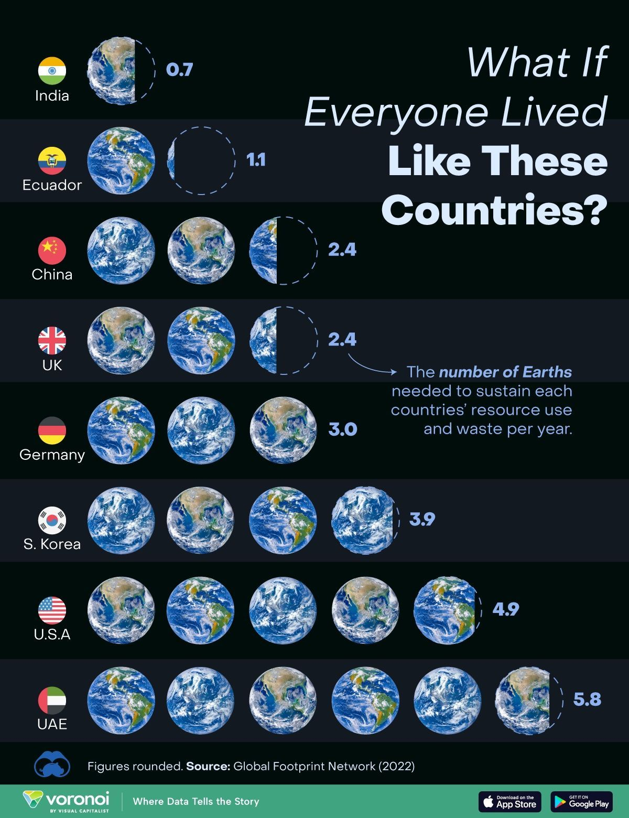
USED SOURCES
PLANET
PEOPLE
PRODUCT
VS
PROFIT
POWER
PARTNERS
Energy security as a factor
of economic stability
SUPPLY STABILITY OF THE
HUMAN AND ENERGY
RESOURCES
DEPENDS ON
SOIL/MINING,
WEATHER,
PARNERSHIPS,
GOVERNMENTS.
VIII. INTERENEF SPLIT, 27.09/2024 PETER BIRO CLIMATE AMBASSADOR, ENERGY TRANSITION UN PROGRAM

Slide 3
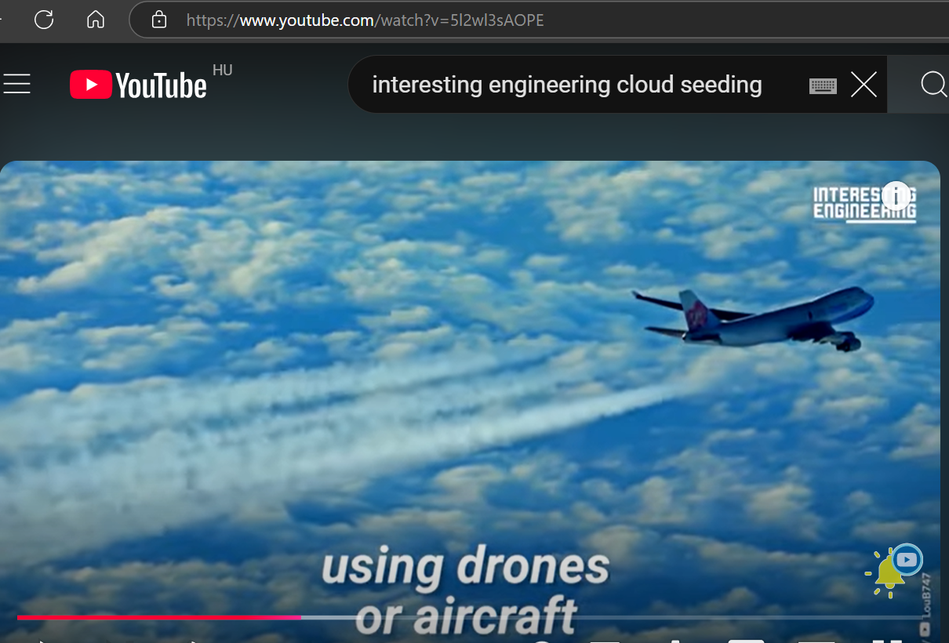
NEW INFUENCERS IN THE ANTHROPOGENIC AFFECTS
52 countries
do this
Energy security as a factor
of economic stability
SUPPLY STABILITY OF THE
HUMAN AND ENERGY
RESOURCES
DEPENDS ON
SOIL,
WEATHER,
PARNERSHIPS,
GOVERNMENTS.
https://youtu.be/5l2wl3sAOPE?si=8bAxt-ui4q8f0CUP
https://youtu.be/ZVLIEIpWQ2k?si=PTfwH-KV0u4avn-U
https://youtu.be/mSrfthEkvOc?si=8ftGND0bSIlyNQwQ
MINI SUN – SECOND SUN
ARTIFICIAL SUN
VIII. INTERENEF SPLIT, 27.09/2024 PETER BIRO CLIMATE AMBASSADOR, ENERGY TRANSITION UN PROGRAM

Slide 4
ALARM PLAN
ALARM
TRAINING
BLACK OUT
Energy security as a factor
of economic stability
SUPPLY STABILITY OF THE
ENERGY USERS
DEPENDS ON
PROVIDERS AS WELL, IMPORTANT
ARE THE SECONDARY AND TERCIARY
SOLUTION TO SOLVE THE BLACKOUT
AND LACK OF THE FUEL DURING
MORE WEEKS, MONTHS, YEARS.
VIII. INTERENEF SPLIT, 27.09/2024 PETER BIRO CLIMATE AMBASSADOR, ENERGY TRANSITION UN PROGRAM

Slide 5
WE USED THE BIG PART OF THE
FOSSILS UNDER 300 YEARS
WHAT
PRODUCED THE NATURE
UNDER 60 BILLION YEARS
CRITICAL ISSUE IS THE
NEXT 10 YEARS ENERGY USING
DUE TO REFLEXION OF THE
ACCELERATED WARMING
VIII. INTERENEF SPLIT, 27.09/2024 PETER BIRO CLIMATE AMBASSADOR, ENERGY TRANSITION UN PROGRAM

Slide 6
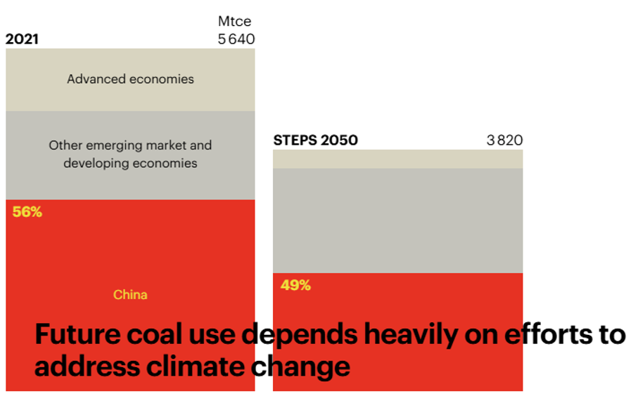
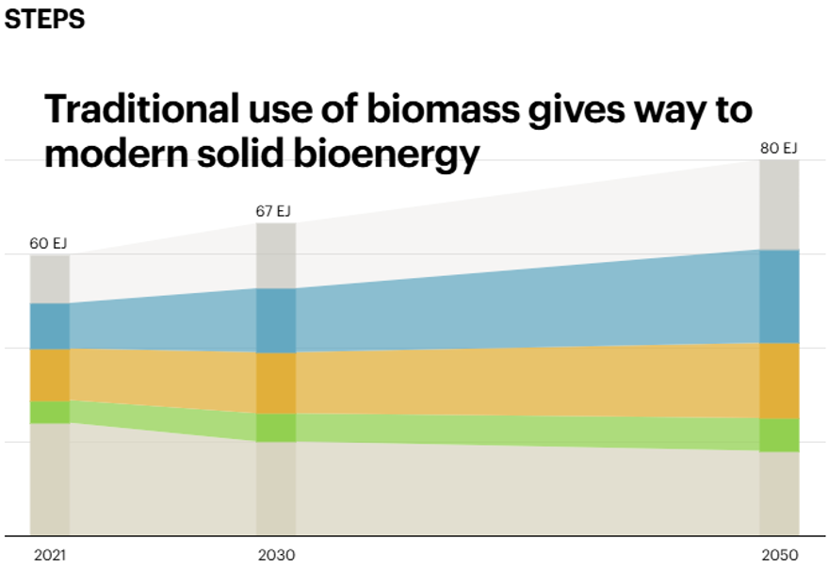
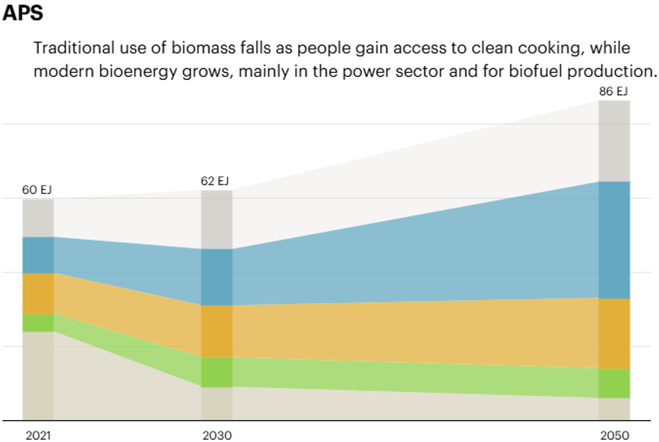
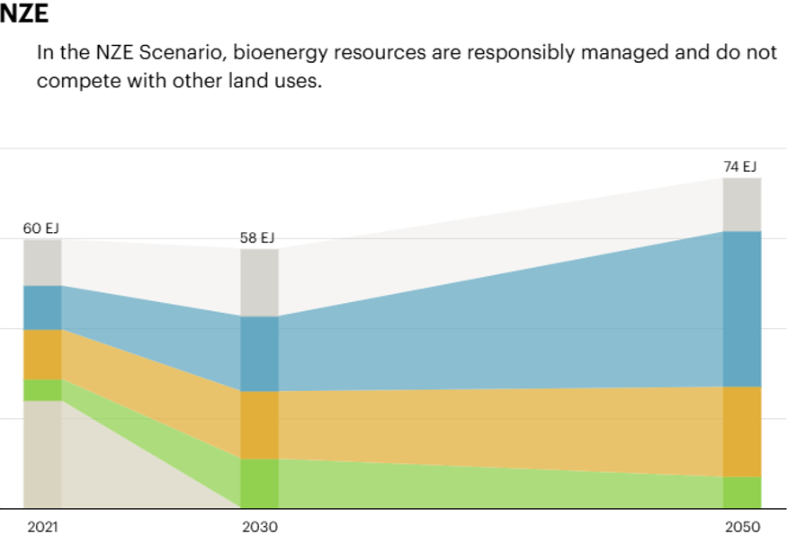
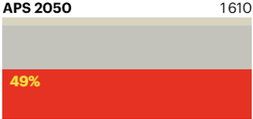
Based on calculation of the IPCC, we can hold the global warming on 1,5°C degrees, if we use maximum 10% of our general energy using. But rather less or zero.
Here are for example the coal burning goals, we did not stop the total fossil fuel using In year 2000. The fair transition gives possibility for new developments, new technologies, also careful with workers, that find another works in COAL OUT (China in red).
VS biomass utility goals for buildings and agriculture (green), industry (yellow), power (blue)
conversion losses (grey) to year 2050 . STEPS APS NZE
STEPS
Stated Policies
Scenario Mtce
from 5640
To 3820
APS
Announced
Pledges
Scenario
to 1610
NZE
Net Zero
to 530
Energy Outlook 2022
of IEA International
Energy Agency
VIII. INTERENEF SPLIT, 27.09/2024 PETER BIRO CLIMATE AMBASSADOR, ENERGY TRANSITION UN PROGRAM

Slide 7
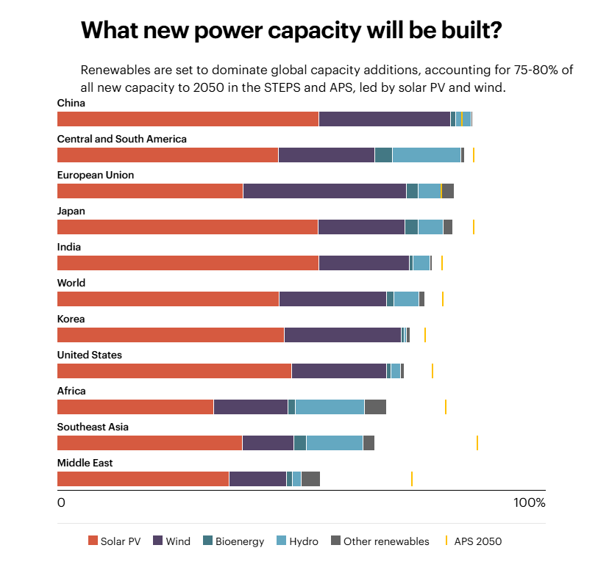
Similar are the reduction demands at the fossil liquid and gas energy sources using by SDG goals
STEPS
Stated Policies
Scenario
APS
Announced
Pledges
Scenario
NZE
Net Zero
Energy Outlook 2022 of IEA International Energy Agency
VIII. INTERENEF SPLIT, 27.09/2024 PETER BIRO CLIMATE AMBASSADOR, ENERGY TRANSITION UN PROGRAM

Slide 8
HOW USE OUR
ENERGY STOCK?
WHAT ESCAPE WAYS
ARE FOR COAL FIRED
POWER PLANTS
IN COAL OUT?
COAL BURNING WITH HIGHER ENERGY EFFICIENCY
BY SIZE AND TEMPERATURE EFFICIENCY
BY OXYFUEL FLUID BED / LEVITATION
BY ICGGT GAS TURBINE USING
BY CATALYTIC OXYDATION
P
https://youtu.be/6nMTu6ZguOU?si=J4ghfKaoCWy8YsLP
BY COAL TO METHANOL
CLEAN COAL TECHNOLOGY
BY GREEN PLUS FUEL
TECHNOLOGY
PAIN FREE GREEN SOLUTION
VIII. INTERENEF SPLIT, 27.09/2024 PETER BIRO CLIMATE AMBASSADOR, ENERGY TRANSITION UN PROGRAM

Slide 9
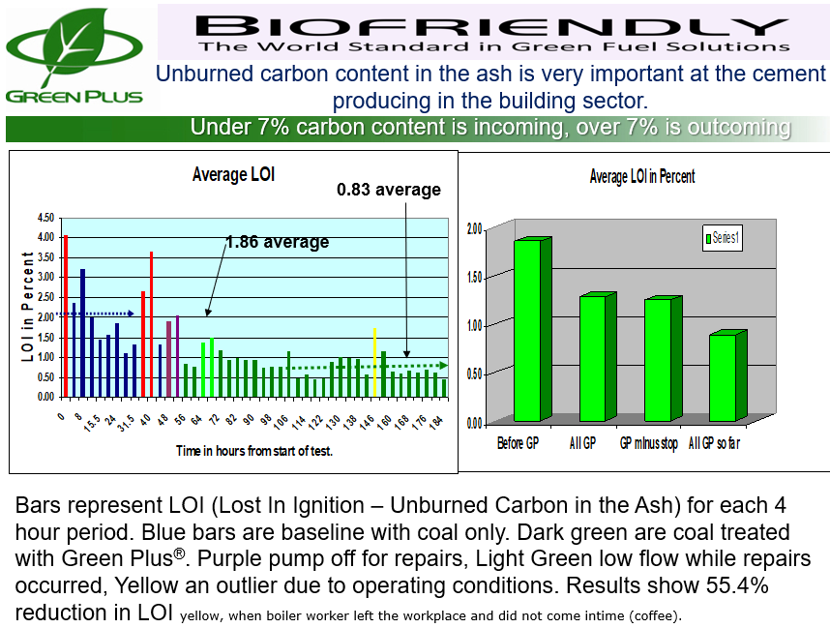
YOUR TURN,
RISK OR
SUSTAINABILITY?
REDUCING
&
RECYCLING
CIRCULAR ECONOMY BY GREEN PLUS
https://youtu.be/6nMTu6ZguOU?si=J4ghfKaoCWy8YsLP
VIII. INTERENEF SPLIT, 27.09/2024 PETER BIRO CLIMATE AMBASSADOR, ENERGY TRANSITION UN PROGRAM

Slide 10
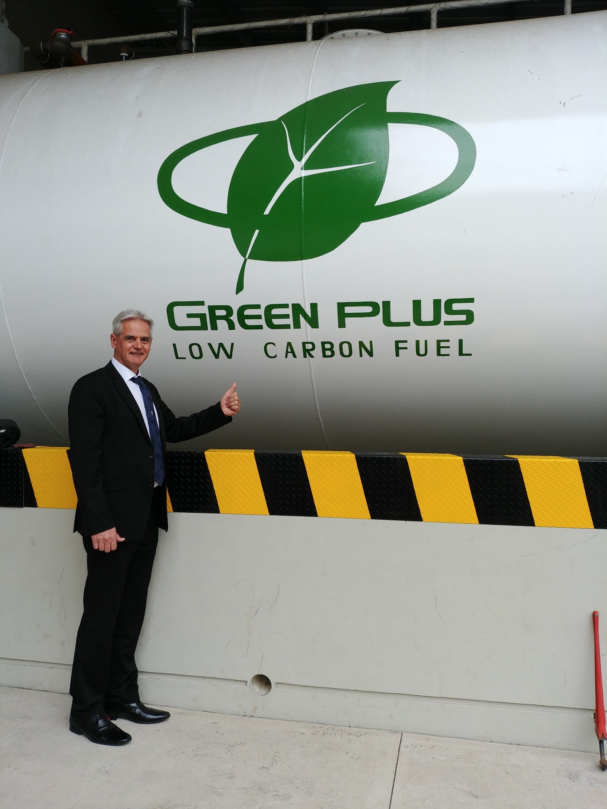
PLANET
PEOPLE
PRODUCT
&
PROFIT
POWER
PARTNERS
E.T. FUND
LUXEMBURG
SDG
ESG
EEO
VIII. INTERENEF SPLIT, 27.09/2024 PETER BIRO CLIMATE AMBASSADOR, ENERGY TRANSITION UN PROGRAM

Slide 11
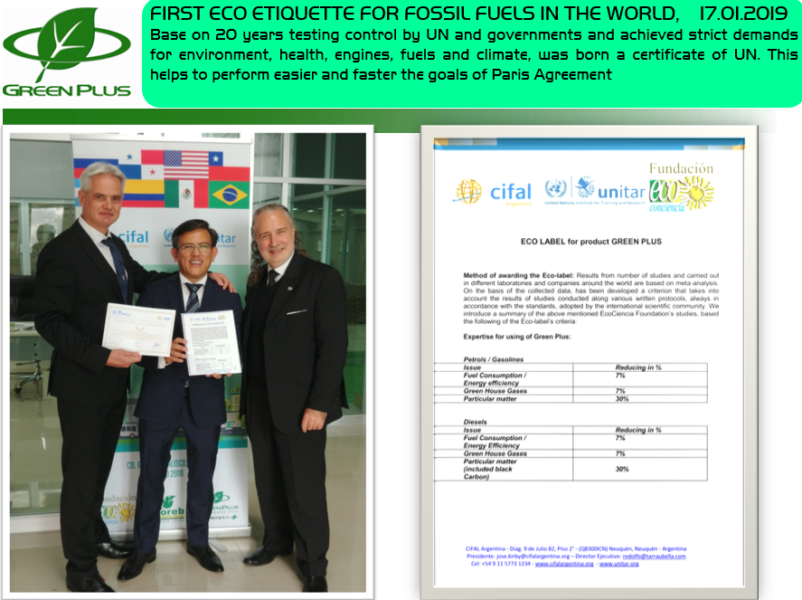
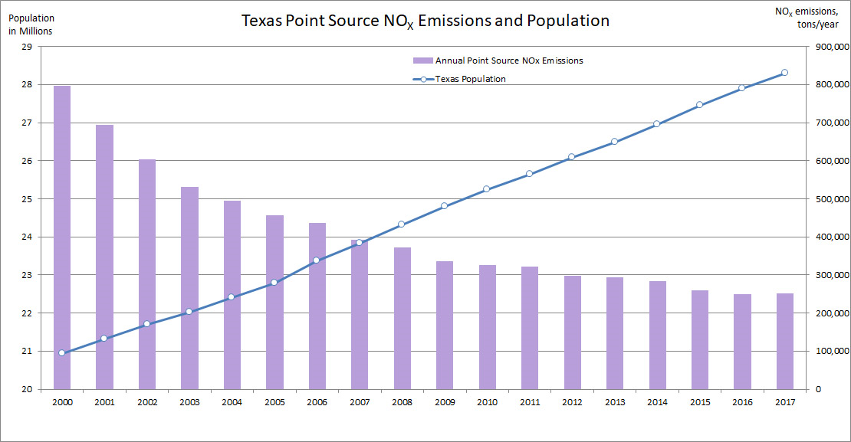
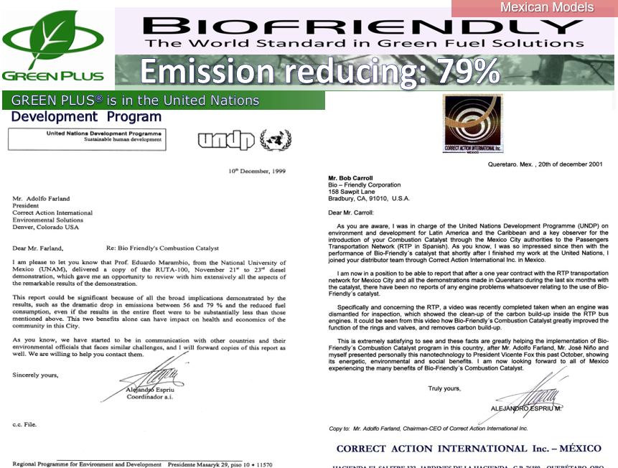
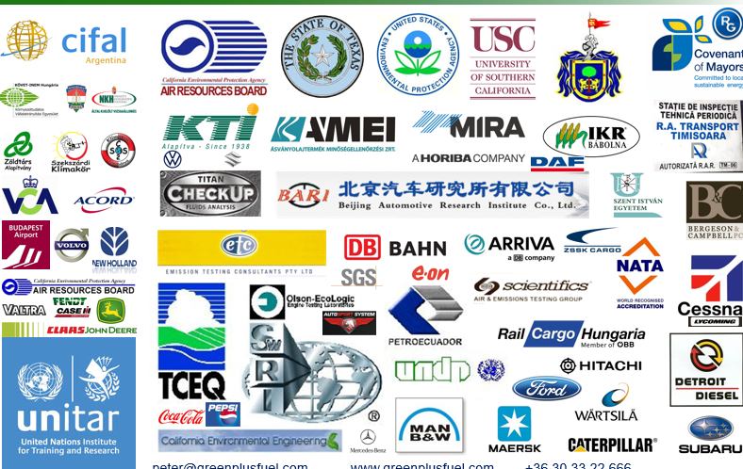
ECO LABELLED FUEL
PRODUCT SINCE 2019
-7% CO2, GHG, FUEL
CONSUMPTION
7% ENERGY EFFICIENCY
-30% BLACK CARBON
PARTICULAR MATTER
NOx -69 % population +35 %
TCEQ TXLED TEXAS
Fuel station successes,
air successes in law and
In zero emission programs
Observed, controlled
by UNTED NATIONS since 1998
Laboratories, governments,
Third parties tested, certified
https://youtu.be/6nMTu6ZguOU?si=J4ghfKaoCWy8YsLP
VIII. INTERENEF SPLIT, 27.09/2024 PETER BIRO CLIMATE AMBASSADOR, ENERGY TRANSITION UN PROGRAM

Slide 12
Strong is the hydrocarbon chain BETWEN 15°C AND 21°C in fuels, over and below are
weaker usually, what influence the direct sunlight, humidity, air pressure, chamber and
pipe pressure, ingredients, additives, bio content, bio type, bio rate, age of the bio content
FUEL CONDITIONER AGAINST OF
CONDENSED WATER
RUSTING
ACIDIFICATION
SALIVATION
BACTERIALYSIS
GELATINIZATION
THICKENING
CLOUDING
SEDIMENTATION
DEPOSIT,
SLUDGE
Able to reduce
the Stress Affects,
brakes those,
stops those.
What’s more repairs, fixes,
Re-refines, renew the bad,
watered, black colored fuels.
Circular economy
Instead of
hazardous waste,
So, sustainable.
https://youtu.be/6nMTu6ZguOU?si=J4ghfKaoCWy8YsLP
SAF
VIII. INTERENEF SPLIT, 27.09/2024 PETER BIRO CLIMATE AMBASSADOR, ENERGY TRANSITION UN PROGRAM

Slide 13
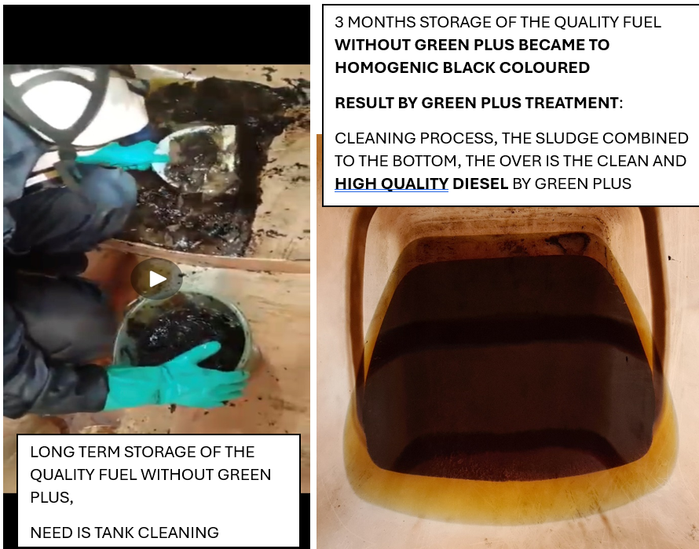
YOUR TURN,
RISK OR
SUSTAINABILITY?
REDUCING
&
RECYCLING
CIRCULAR ECONOMY BY GREEN PLUS
VIII. INTERENEF SPLIT, 27.09/2024 PETER BIRO CLIMATE AMBASSADOR, ENERGY TRANSITION UN PROGRAM

Slide 14
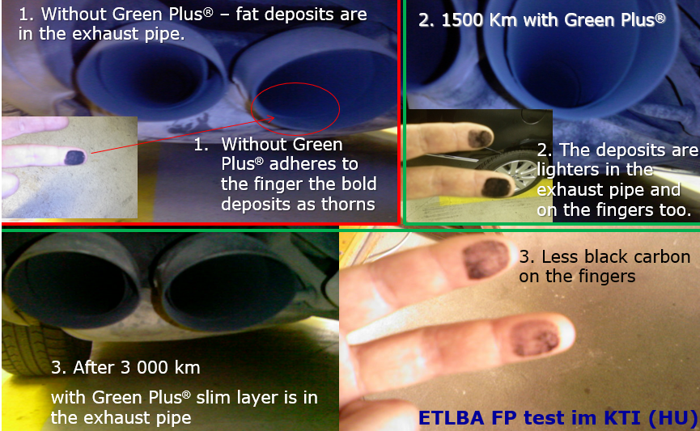
SMOKE MASS REDUCTION
ABILITY IS BETWEEN 50% AND 99% DEPENDS ON FUEL AND ITS CARBON CONTENT
GREEN PLUS HEALS, NURSES THE TOTAL SYSTEM FROM THE FUEL TANK TO THE EXHAUST PIPE ON VERY GENTLE, SOFTLY WAY, REDUCES THE PROBLEMS BY FUEL PARTS, SENSORS, FUEL FILTERS, DOSERS, INJECTORS, CHECK ENGINE ALARMS, DPF, GPF, SONDA, SCR, CATALYST, ADBLUE SYTEM, TURBO, EGR. ETC..
VIII. INTERENEF SPLIT, 27.09/2024 PETER BIRO CLIMATE AMBASSADOR, ENERGY TRANSITION UN PROGRAM

Slide 15
RECOMMENDATIONS
RISK VS COMFORT CHIP – BLOCK CHAIN - AI
WILL BE REGULATED AND WELL CONTROLLED
Need is very precise forecast about weather to calculate the input - output of the smart grid nets. Have to calculate the weather dependent energy producer wind, solar technologies, also the industry and householder energy using in peaks and sharing, storing in puffers.
Need is higher security service against of terrorism (north stream natural gas pipeline). Have to create a common platform in energy crisis and in war situation, necessary the communication and understanding.
Need is multilateral connections to give and receive energy between municipalities, between countries, between continents.
Need is support for hidden technologies, what blocked by threats, chantage, extorsions of lobbies, accidents by unknow causes.
Find the local preferred solutions by nature. Heat pump, geothermal, hydro energy, PV, water/wave and waste, wind, dynamo systems, generators, biomass, biogas, ammonia, methane, hydrogen (combustion and cells), CO₂ burning, stone and magnetic energies, levitation technology, algae, fungous, enzyme processors, weight and colour changing energy, flow energy, small nuclear reactors similarly to microwave oven, etc.. and fuel/energy storage will be ensured as secondary and tertiary reserve in conventional batteries, Li, natrium, cobalt, dust, gel, water storage and in tanks too, also the gases as methane, CO₂, hydrogen we can use as energy storage as well. Be responsible, use everything in harmony of the nature!
Need is local energy sources and long term ability energy storages, big capacity on safety way.
VIII. INTERENEF SPLIT, 27.09/2024 PETER BIRO CLIMATE AMBASSADOR, ENERGY TRANSITION UN PROGRAM

Slide 16
Peter BIRO https://www.linkedin.com/in/peter-biro-7a6b568/
Ambassador, Climate-Friendly Municipalities
Owner, international manager, fuel testing expert
UN Project Manager Green Plus Group
+36 30 33 22 666 WhatsApp Viber peter@greenplusfuel.com
www.okocimkesuzemanyag.hu www.unitar.org www.klimabarat.hu
Skype & Facebook & Instagram & YouTube & TikTok: greenplusfuel
https://biofriendly.com/
https://horebenergy.com/ https://greenplus-latam.com/greenplus.html
https://gulfmexico.mx/technology/
https://dislubenergia.com.br/
links – presentations, videos, reports, news
https://www.greenplusfuel.com/linkek.pdf
VIII. INTERENEF SPLIT, 27.09/2024 PETER BIRO CLIMATE AMBASSADOR, ENERGY TRANSITION UN PROGRAM
Notes:
16

